Slide 1
Airbnb Data Challenge Model Results
To find the opportunities​ ​to​ ​increase​ ​successful​ ​guest-host​ ​matching​, where inquiries usually follow the steps of being replied -- accepted -- booked, three models were built each to find the:
Drivers of Reply
Drivers of Acceptance
Drivers of Confirmation for Booking

Slide 2
Drivers of Reply
Logistic Regression model is used to predict what drives hosts' reply for all inquiries made in Contact Me and Book It channel
Important drivers of hosts’ reply are:
Number of reviews for the listing
First message length
Lead time
Inquiries in Instant Book channel and inquiries where reply timestamp equals accept timestamp are excluded.
Model performance:
AUC score: 0.64
Accuracy: 0.88

Slide 3
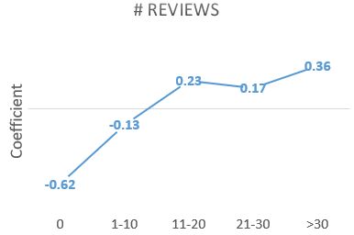
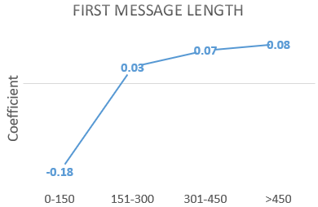
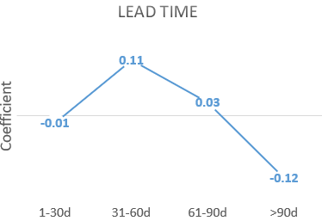
How do # reviews, first message length, and lead time drives reply
Having more than 10 reviews significantly increases the probability of reply
Hosts who reply more are matched for more bookings and therefore have more reviews
Can consider to promote new hosts so that they can have more chance to get reviews and increase bookings
Messages with more than 150 characters are likely to be replied, messages too short(0-150 characters) have a lower chance to be replied.
Short messages give too little information for hosts to reply to the inquiries.
Can encourage guests to send longer message (>150 characters) and prompt for desired information of hosts
Inquiries with long lead time (>90d) have a lower chance to be replied.
Inquiries made too far ahead of check-in may increase the difficulty for hosts to arrange for the trip.
(recommandation?)

Slide 4
Drivers of Acceptance
Logistic Regression model is used to predict what drives hosts' acceptance for replied inquiries in Contact Me and Book It channel
Important drivers of guests’ confirmation are:
Number of interactions
Number of reviews
Lead time
Days of stay
Reply time
First message length
Guest size
Inquiries in Instant Book channel and inquiries where reply timestamp equals accept timestamp are excluded.
Model performance:
AUC score: 0.79
Accuracy: 0.76

Slide 5
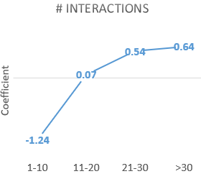
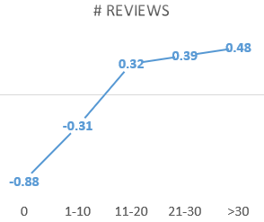
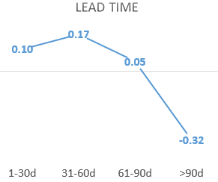
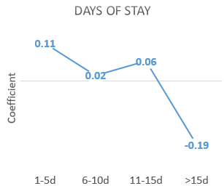
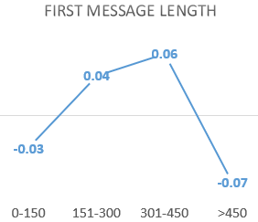
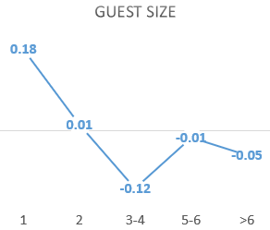
How does each driver impact acceptance
More than 20 interactions significantly increases the probability of acceptance, and having less than 10 interactions decreases it
Hosts whose listings have more than 10 reviews are more likely to accept the inquiries than those whose listings have less than 10 reviews
Inquiries made less than 90 days before check-in are more likely to be accepted
Inquiries for less than 15 days of stay are likely to be accepted
Inquiries with message between 150 and 450 characters are more likely to be accepted
Inquiries for single guest are most likely to be accepted, and inquiries for more than 2 guests are less likely to be booked

Slide 6
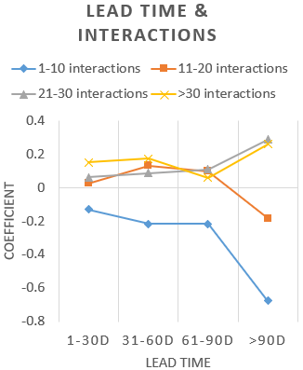
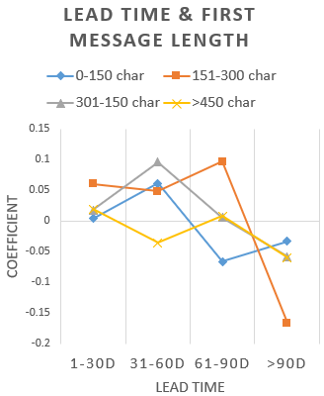
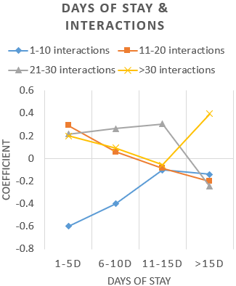
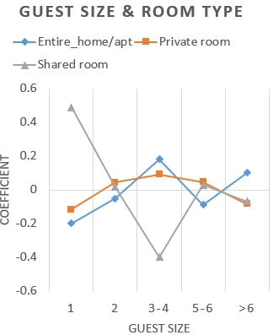
Interactions between some variables
Having less than 10 interactions decreases the probability of acceptance across all lengths of stay
When stay <= 5 days, interaction between 11 - 20 benefits acceptance the most
When stay between 6 - 15 days, interaction between 21 - 30 benefits acceptance the most
When stay > 15 days, need more than 30 interactions to drive acceptance
When guest size = 1, inquiries for a shared room are most likely to be accepted
When guest size = 2, inquiries for an entire_home/apt are less likely to be accepted
When guest size between 3 - 4 or > 6, inquiries for an entire_home/apt are most likely to be accepted
When guest size between 5 - 6, inquiries for an entire_home/apt are less likely to be accepted
Having more than 10 interactions drives up the probability of acceptance from negative to positive for lead times < 90 days
For inquiries with lead time >90 days, need more than 20 interactions to drive acceptance
When lead time between 31 - 60 days, sending long messages(> 450 char) drags down acceptance rate
When lead time between 61 - 90 days, sending short messages(< 150 char) drags down acceptance rate

Slide 7
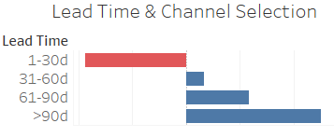

Additional findings
Probability
Slope = -0.2506
Inquiries made within 30 days before check-in are more likely to be accepted in Book it channel
Inquiries made more than 30 days before check-in are more likely to be accepted in Contact Me channel
Reply Time
Each additional minute decreases the probability of acceptance
Hosts who reply sooner are more likely to accept the inquiries

Slide 8
Drivers of Confirmation for Booking
Important drivers of hosts’ acceptance are:
Number of interactions
Number of reviews
User stage
Days of stay
Accept time
Lead time
Logistic Regression model is used to predict what drives guests’ confirmation for accepted inquiries in Contact Me channel
Model performance:
AUC score: 0.88
Accuracy: 0.89

Slide 9
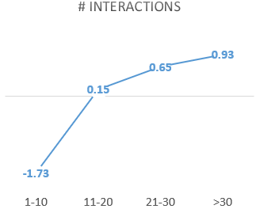
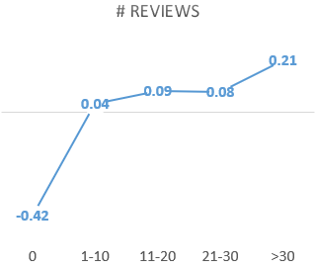
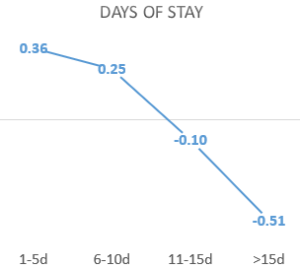
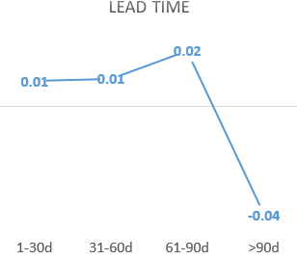
How does each driver impact acceptance
More than 20 interactions significantly increases the probability of confirmation from hosts, and having less than 10 interactions decreases it
Guests are less likely to confirm the booking if the listings have 0 reviews but more likely to confirm those with more 30 reviews
Inquiries for less than 10 days of stays are more likely to be confirmed, but inquiries for more than 15 days of stays are less likely to be confirmed
Guests are less likely to confirm accepted inquiries if they are made more than 90 days before check-in

Slide 10
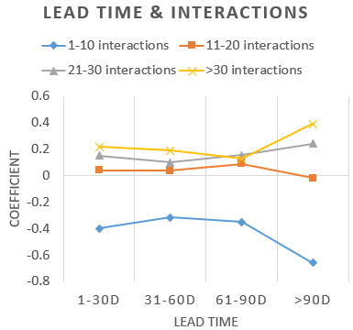
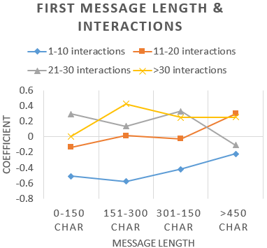
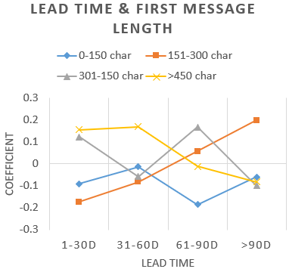
Interactions between some variables
Having more than 10 interactions drives up the probability of confirmation from negative to positive for lead time within 90 days
For inquiries with lead time >90 days, need more than 20 interactions to drive confirmation
When message length <= 150 char, 21-30 interactions benefits confirmation the most
When message length between 151 - 300 char, > 30 interactions benefits confirmation the most
When message length between 301 - 450 char, need more than 20 interactions to drive confirmation
When message length > 450 char, 21-30 interactions doesn't benefit confirmation but 11 - 20 does the most
When lead_time <= 60 days, long messages(>450 char) benefits confirmation
When lead_time between 60 - 90 days, long messages(>450 char) don't benefits confirmation, but intermediate length messages (301- 450 char) do
When lead_time >90 days, only messages between 150 - 300 char benefit confirmation

Slide 11
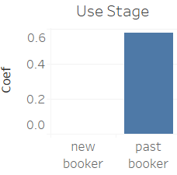
Additional findings
Accept time
Probability
Slope = 0.0656
Accept time
Past bookers are more likely to confirm bookings after the inquiries are accepted, may because of their trust in the process and the platform
Longer accept time increases the probability of confirmation
Longer accept time may be the result of more interactions between hosts and guests, and therefore guests are more likely to confirm the booking

Slide 12
Summary of Important Drivers
Number of Interactions
Interactions drive acceptance and confirmation regardless of long lead time, days of stay, and short messages
Number of Reviews
Hosts with more reviews are more likely to reply and accept, and reviews drive guests’ confirmation as well
Guest size+room type
Appropriate room types for different guest sizes can increase the probability of acceptance
First Message Length
Message length impacts all three steps from reply to confirmation when paired with different interactions and lead time

